Slide 1
Data Engineering

Slide 2
AGENDA
Introduction
Data Engineering
Data Storage
Data Processing
Cloud
IaaS – PaaS - SaaS
Data Services – Cloud

Slide 3
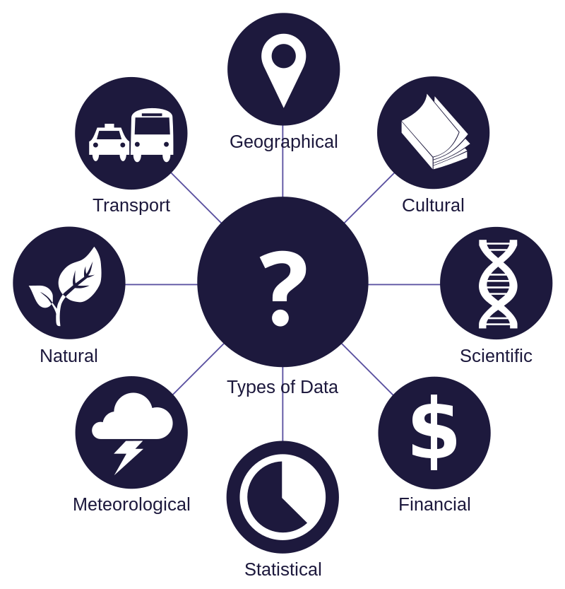
INTRODUCTION
Data is a collection of discrete values that convey information, describing quantity, quality, fact, statistics, other basic units of meaning, or simply sequences of symbols that may be further interpreted. A datum is an individual value in a collection of data. Data is usually organized into structures such as tables that provide additional context and meaning, and which may
themselves be used as data in larger structures.

Slide 4
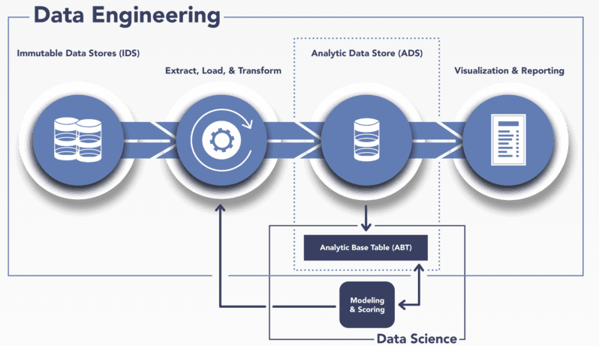
Data engineering
Data engineering refers to the building of systems to enable the collection and usage of data. This data is usually used to enable subsequent analysis and data science.
Analyze and organize raw data.
Build data systems and pipelines.
Evaluate business needs and objectives.
Interpret trends and patterns.
Conduct complex data analysis and report on results.
Prepare data for prescriptive and predictive modeling.
Build algorithms and prototypes.

Slide 5
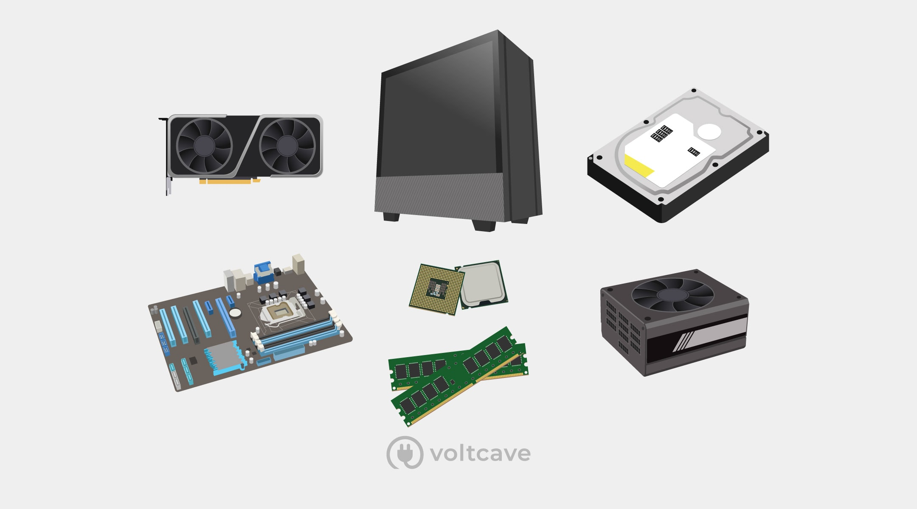
Data Storage

Slide 6



networking

Slide 7

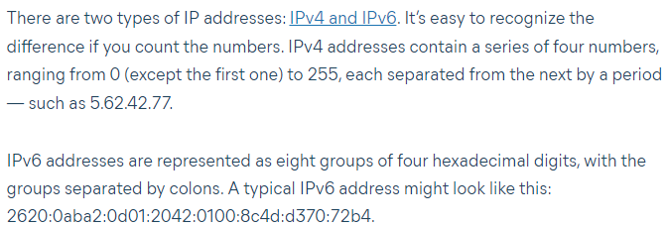
networking
What is an IP Address?
An IP address is a string of numbers separated by periods. IP addresses are expressed as a set of four numbers — an example address might be 192.158.1.38. Each number in the set can range from 0 to 255. So, the full IP addressing range goes from 0.0.0.0 to 255.255.255.255.
IP addresses are not random. They are mathematically produced and allocated by the Internet Assigned Numbers Authority (IANA), a division of the Internet Corporation for Assigned Names and Numbers (ICANN). ICANN is a non-profit organization that was established in the United States in 1998 to help maintain the security of the internet and allow it to be usable by all. Each time anyone registers a domain on the internet, they go through a domain name registrar, who pays a small fee to ICANN to register the domain.
Consumer IP addresses
Private IP addresses
Public IP addresses
Dynamic IP addresses
Static IP addresses

Slide 8
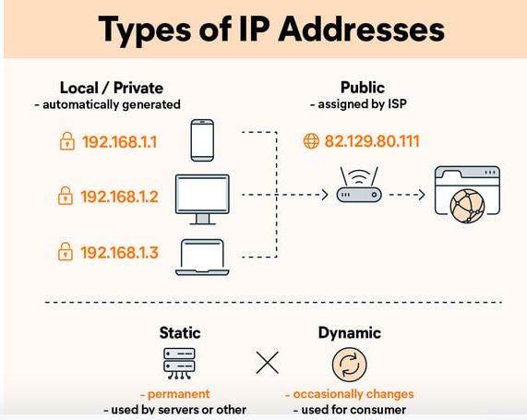
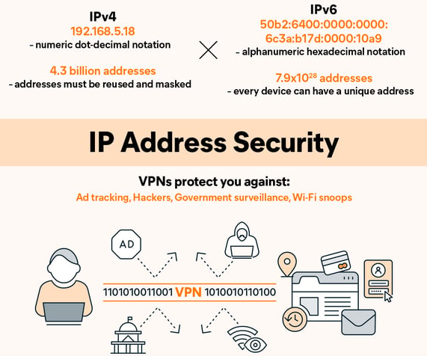
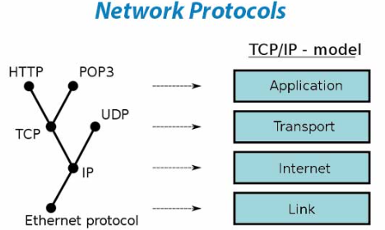
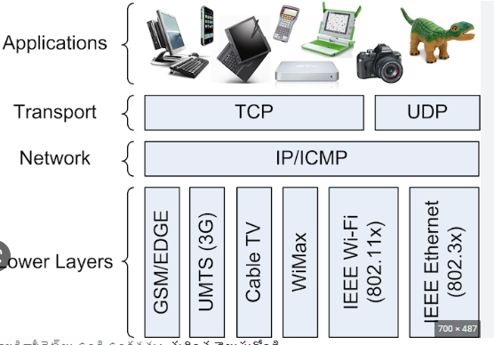

Slide 9
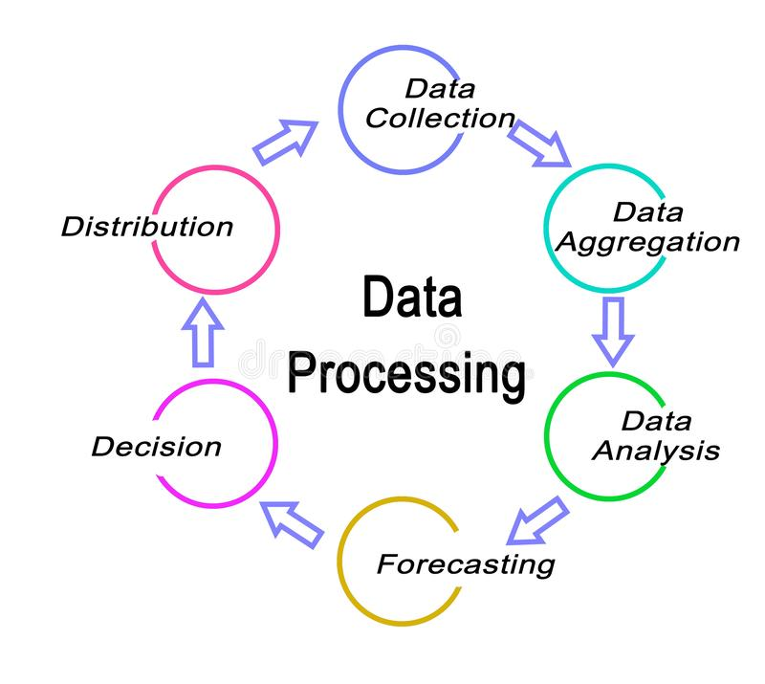
DATA PROCESSING

Slide 10
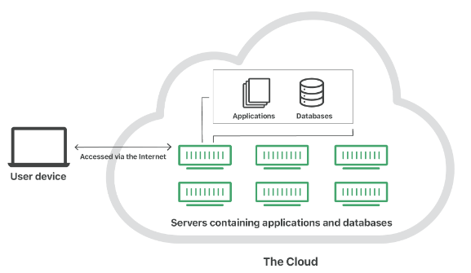



cloud
"The cloud" refers to servers that are accessed over the Internet, and the software and databases that run on those servers. Cloud servers are located in data centers all over the world. By using cloud computing, users and companies do not have to manage physical servers themselves or run software applications on their own machines.
Cloud computing is possible because of a technology called virtualization.
Virtualization allows for the creation of a simulated, digital-only "virtual" computer that behaves as if it were a physical computer with its own hardware.
The technical term for such a computer is virtual machine.

Slide 11
Types of cloud
Private cloud: A private cloud is a server, data center, or distributed network wholly dedicated to one organization.
Public cloud: A public cloud is a service run by an external vendor that may include servers in one or multiple data centers. Unlike a private cloud, public clouds are shared by multiple organizations. Using virtual machines, individual servers may be shared by different companies, a situation that is called "multitenancy" because multiple tenants are renting server space within the same server.
Hybrid cloud: hybrid cloud deployments combine public and private clouds and may even include on-premises legacy servers. An organization may use their private cloud for some services and their public cloud for others, or they may use the public cloud as backup for their private cloud.
Multi-cloud: multi-cloud is a type of cloud deployment that involves using multiple public clouds. In other words, an organization with a multi-cloud deployment rents virtual servers and services from several external vendors — to continue the analogy used above, this is like leasing several adjacent plots of land from different landlords. Multi-cloud deployments can also be hybrid cloud, and vice versa.

Slide 12
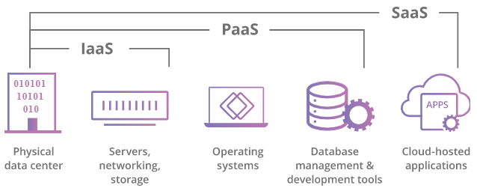
Cloud Service Offerings

Slide 13
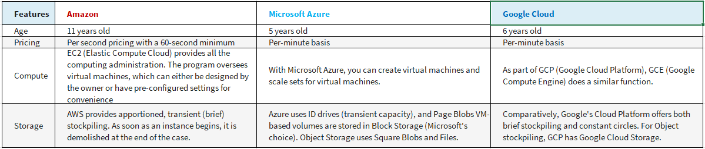
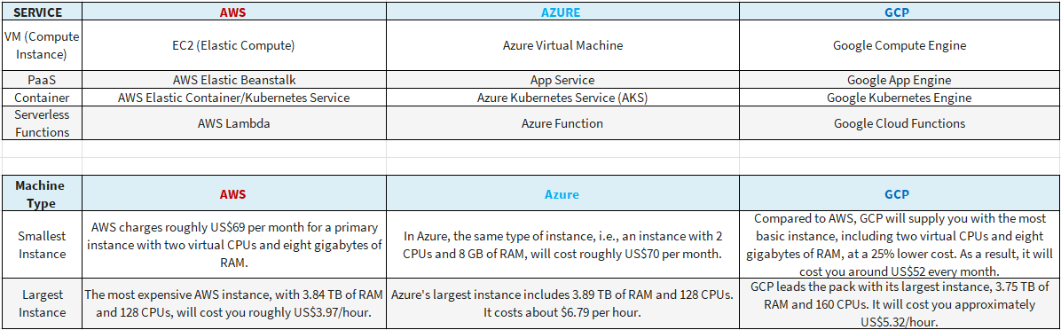
Cloud data services

Slide 14



AREAS OF FOCUS
CLOUD-BASED
Data Services

Slide 15

SUMMARY

Slide 16
THANK YOU
Chakrapani
chakri@kasmo.co
www.kasmo.co

